Slide 1

Writing English Papers
《学术英语论文写作》
Lecturer: Liu Xindan

Slide 2
Revising Your Draft
Writing Research Papers
Chapter 7
Drafts
rough draft
draft for your readers
finalizing the paper
Chapter 7 Revising Your Draft

Slide 3
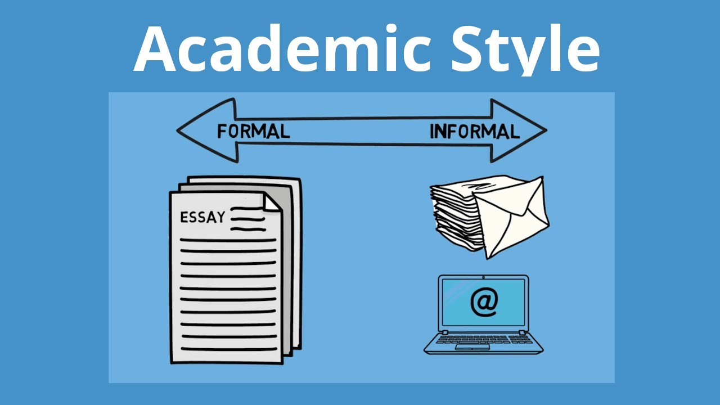
Chapter 7 Revising Your Draft

Slide 4

Revising Your Draft
Writing Research Papers
Chapter 7
1. Language Style
2. Rhetorical Principles
3. Redundancy
Contents
Chapter 7 Revising Your Draft

Slide 5

Revising Your Draft--1 Language Style
Writing Research Papers
Chapter 7
1 Language Style
Chapter 7 Revising Your Draft

Slide 6
Revising Your Draft--1 Language Style
Writing Research Papers
Chapter 7
1 Language Style
Features:
Formal
Objective
Concise
Varied
Chapter 7 Revising Your Draft

Slide 7
Revising Your Draft--Formal
Writing Research Papers
Chapter 7
Formality
Avoid slang and too-casual language, e.g. “cool” or “pretty awful”.
Use full forms of words rather than abbreviations, e.g., “does not, should
have, it is” rather than “doesn’t, should’ve, it’s”.
Avoid phrasal verbs, e.g. “look into”, preferring single polysyllabic verbs,
e.g. “investigate”.
Use powerful reporting words: “support, claim, suggest, recommend, and
contradict”.
Chapter 7 Revising Your Draft

Slide 8
Revising Your Draft--Formality
Writing Research Papers
Chapter 7
Make less use of coordination and greater use of subordination.
Avoid informal punctuation such as contractions and dashes; colons and
semi-colons feature commonly in academic style.
Use complex rather than simple sentences, and long rather than short
paragraphs.
Avoid the use of rhetorical questions.
Chapter 7 Revising Your Draft

Slide 9
Revising Your Draft--Formality
Writing Research Papers
Chapter 7
The investigation has been going for four years. How good has it been? At this stage, researchers can’t tell, because they still need to check out the data to account for differences in age, gender, socio-economic-status, etc. Once that work is done though, the information will be really first-class.
This passage contains some informal words (going, good, tell, though, really), a rhetorical question (How good…?), a contraction (can’t), a vague category (etc.) and a colloquialism (first-class, top notch, check out).
Chapter 7 Revising Your Draft

Slide 10
Revising Your Draft--Formality
Writing Research Papers
Chapter 7
The investigation has been going for four years. How good has it been? At this stage, researchers can’t tell, because they still need to check out the data to account for differences in age, gender, socio-economic-status, etc. Once that work is done though, the information will be really first-class.
The investigation has been underway for four years. Researchers cannot yet determine the effectiveness of the project because it is necessary to first analyse the data to control for age, gender, socio-economic status and other demographic variables. Despite this, the information collected is expected to be highly valuable for future studies.
Chapter 7 Revising Your Draft

Slide 11
Revising Your Draft--Formality
Writing Research Papers
Chapter 7
Online learner’s dictionaries that provide examples of how words are used in context can help you determine the formality of specific words. If a word has many possible meanings, or appears in many idioms, it is more likely to be informal.
Tips
Chapter 7 Revising Your Draft

Slide 12
Revising Your Draft--Formality
Writing Research Papers
Chapter 7
Exercise 1 Rewrite the following sentences in more formal academic English:
1. Export figure won’t improve until the economy is stronger.
2. Scientists are looking into innovative ways to combat AIDS.
3. Rice and aquatic products make up a major part of the diet of the people in
the Mekong Delta, Vietnam.
4. Worldwide consumption of pesticides has gone up to 2.6 million metric
tons.
Chapter 7 Revising Your Draft

Slide 13
Revising Your Draft--Formality
Writing Research Papers
Chapter 7
5. You can understand something better if it is repeated.
6. Crime was increasing rapidly and the police were becoming concerned.
7. Did you know that spoken and written language are very different?
Chapter 7 Revising Your Draft

Slide 14
Revising Your Draft--Objectivity
Writing Research Papers
Chapter 7
Objectivity
Academic writing presents and evaluates issues and arrives at an objective position; a position that focuses on and is informed by research and reasoning rather than personal feelings and opinions.
Personal pronouns, especially ‘I’, ‘you’ and ‘we’ are usually avoided, as these are often associated with subjective views that are influenced by personal preferences or biases.
Chapter 7 Revising Your Draft

Slide 15
Revising Your Draft--Objectivity
Writing Research Papers
Chapter 7
Use referencing to indicate sources.
Use impersonal expressions and the passive voice, e.g. it can be concluded that.., it
has been claimed tbat...
Use third person pronouns, avoid the first person “I, we” or second person “you”.
Avoid sexist and biased language, for example, using “old persons” instead of
“elderly”.
Avoid words that have emotional or attitudinal connotations.
Chapter 7 Revising Your Draft

Slide 16
Revising Your Draft--Objectivity
Writing Research Papers
Chapter 7
Example
This statement sounds a bit like a personal opinion:
You can demonstrate that climate change is a real phenomenon by studying alterations in Antarctic ice layers.
Chapter 7 Revising Your Draft

Slide 17
Revising Your Draft--Objectivity
Writing Research Papers
Chapter 7
Exercise 2 Rewrite the following sentences in more objective, academic English:
1. I think that all guns should be banned.
2. I think objectivity on television is nothing more than an ideal.
3. I found that the vocabulary choice played a role in determining which topics speakers
take up.
4. I observed 43 students of a third-grade class at Barksdale School for two weeks.
5. The doctor prepared his necessary surgical equipment.
6. This has had enormous impact...
Chapter 7 Revising Your Draft

Slide 18
Revising Your Draft--Objectivity
Writing Research Papers
Chapter 7
Exercise 2 The sentences can be written in more objective, academic English like the following:
1. There is a case for stricter government control on guns.
2. Objectivity in television broadcasting is nothing more than an ideal.
3. Vocabulary choice evidently plays a role in determining which topics are taken up by speakers.
4. Forty-three students of a third-grade class at Barksdale School were observed for two weeks.
5. The doctor prepared the necessary surgical equipment
6.The significant influences of this change may be attributed to.
Chapter 7 Revising Your Draft

Slide 19
Revising Your Draft--Conciseness
Writing Research Papers
Chapter 7
Conciseness
The quality of being short and clear, and expressing what needs to be said without unnecessary words.
The goal of concise writing is to use the most effective words. Concise writing does not always have the fewest words, but it always uses the strongest ones. Writers often fill sentences with weak or unnecessary words that can be deleted or replaced.
Chapter 7 Revising Your Draft

Slide 20
Revising Your Draft--Conciseness
Writing Research Papers
Chapter 7
Be precise and specific.
Try to use the most straightforward term and reduce unnecessary words.
No clichés, redundant words or colloquialisms.
Use the specific terminology of your subject or discipline.
Become a ruthless editor, cutting out as much dead-wood as possible.
Delete words that don’t add anything to your sentence.
Chapter 7 Revising Your Draft

Slide 21
Revising Your Draft--Conciseness
Writing Research Papers
Chapter 7
Cut the overlap.
Our current staffing problems have been exacerbated by a combination of low salaries and the rising cost of housing. Because it has become more expensive for employees to rent or buy homes in our target cities, we are not able to attract employees with our current salaries, which leads to staffing difficulties. (52 words)
Our current staffing problems have been exacerbated by a combination of low salaries and the rising cost of housing for renters and buyers in our target cities. (27 words)
Chapter 7 Revising Your Draft

Slide 22
Revising Your Draft--Conciseness
Writing Research Papers
Chapter 7
Instead of telling us what you’re going to do in a sentence, just do it.
Consider these two sentences:
I will now offer you three steps we should take to improve our onboarding process. (15 words)
We should take three steps to improve our onboarding process. (10 words)
Chapter 7 Revising Your Draft

Slide 23
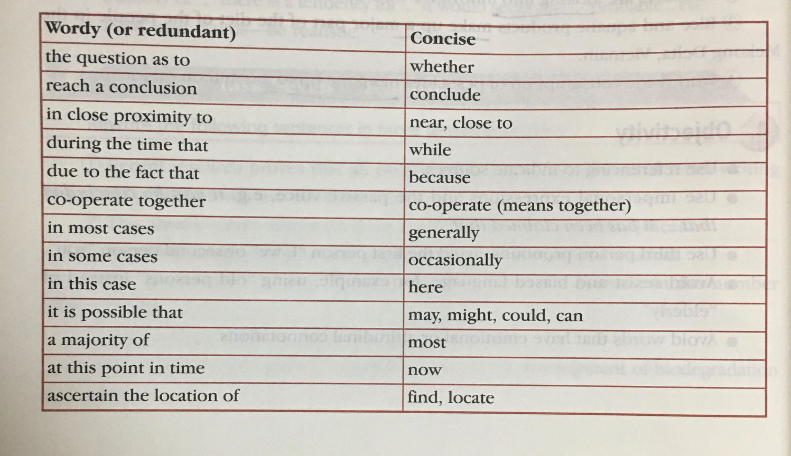
Revising Your Draft--4. Conciseness
Writing Research Papers
Chapter 7
Chapter 7 Revising Your Draft

Slide 24
Revising Your Draft--Variety
Writing Research Papers
Chapter 7
Variety
Use a variety of words. Avoid repetition of the same words.
If certain word must be repeated, reference words, synonyms or different forms of
the word can be used to refer to it without repeating.
Use a variety of logical connectors. Avoid the overuse or misuse of certain
logicalconnectors, especially “besides”,“furthermore” and“moreover”.
Use a variety of sentence structures. Avoid the overuse of certain favorite structure.
Chapter 7 Revising Your Draft

Slide 25
Exercise 3: Correct the following sentences to make them more academic.
1. The university is asking for more money.
2. Is it really true that the Great Wall of China is visible from space?
3. Some commentators say that students lack creativity. They also lack imagination.
4. According to Wong (2003, p.41), he says that the information is inaccurate.

Slide 26
Exercise 4: Change the following spoken text into a written text.
Spoken text
Nowadays companies 1. are finding that they have to change the way they do things and 2. they’re finding that human resources planning is really helpful when they have to do this. One reason why it’s helpful is because it can help the companies 3. work out what the issues are and then, when 4. you’ve done that, it can help 5. you make up your mind what 6. you’re going to do about it. Basically, human resource planning is what 7. you do when you’re going through…

Slide 27
Written text
As companies experience the need for change, they often apply human resource planning to define the relevant issues and develop responses to them. Broadly defined, human resource planning is the process of analyzing an organization’s human resources needs under changing conditions and developing the activities necessary to satisfy those needs.

Slide 28
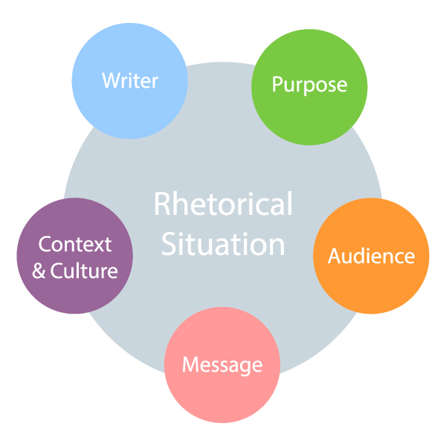
Revising Your Draft--2 Rhetorical Principles
Writing Research Papers
Chapter 7
2 Rhetorical Principles
Chapter 7 Revising Your Draft

Slide 29
Revising Your Draft--Rhetorical Principles
Writing Research Papers
Chapter 7
Rhetorical Principles
Unity
Coherence
Emphasis
Chapter 7 Revising Your Draft

Slide 30
Revising Your Draft--Rhetorical Principles
Writing Research Papers
Chapter 7
2.1 Unity
A paper should stick to its chosen thesis without rambling.
2.2 Coherence
“Sticking together”
Ways of improving coherence
---using transitional expressions (and, or, but for etc. )
---repeating key words and phrases
---using pronoun reference
---using parallel form
Chapter 7 Revising Your Draft

Slide 31
Revising Your Draft--Rhetorical Principles
Writing Research Papers
Chapter 7
Eg. Fleas of various species can jump 150 times their own length, can survive months without feeding, can accelerate 50 times faster than the space shuttle, can withstand enormous pressure, and can remain frozen for a year and then revive.
Chapter 7 Revising Your Draft

Slide 32
Revising Your Draft--Rhetorical Principles
Writing Research Papers
Chapter 7
Listing Points to Show New Ideas:
Firstly, First of all, To begin, Secondly, Finally, Furthermore, In addition, Also, Moreover
Chapter 7 Revising Your Draft

Slide 33
Revising Your Draft--Rhetorical Principles
Writing Research Papers
Chapter 7
Showing an Example:
For example, For instance, To illustrate, A case in point
Showing Contrast:
However, On the other hand, In contrast
Chapter 7 Revising Your Draft

Slide 34
Revising Your Draft--Rhetorical Principles
Writing Research Papers
Chapter 7
Showing a Result:
Therefore, As a result, Consequently, Thus
Showing time: (commonly in essay introductions)
These days, Nowadays, At present
Chapter 7 Revising Your Draft

Slide 35
Revising Your Draft--Rhetorical Principles
Writing Research Papers
Chapter 7
To introduce concluding comments:
To conclude, In conclusion, In brief, All in all
Chapter 7 Revising Your Draft

Slide 36
Revising Your Draft--Rhetorical Principles
Writing Research Papers
Chapter 7
Two ways of using transitional words
1) Full-stop, capital letter, comma
Eg. There are many ways to improve congestion. For example, some cities in The Netherlands have pedestrian only city centres.
Many countries have now reduced their CO2 emissions. As a result, there is now less pollution.
Chapter 7 Revising Your Draft

Slide 37
Revising Your Draft--Rhetorical Principles
Writing Research Papers
Chapter 7
2) Semi-colon, small letter, comma
Eg.There are many ways to improve congestion; for example, some cities in The Netherlands have pedestrian only city centres.
Many countries have now reduced their CO2 emissions; as a result, there is now less pollution.
Chapter 7 Revising Your Draft

Slide 38
Revising Your Draft--Rhetorical Principles
Writing Research Papers
Chapter 7
Other ways of using transitional words
1) Giving Examples
Eg. There are many ways to improve congestion. Some cities in The Netherlands, for instance, have pedestrian only city centres.
There are many ways to improve congestion. Some cities in The Netherlands have, for instance, pedestrian only city centres.
Chapter 7 Revising Your Draft

Slide 39
Revising Your Draft--Rhetorical Principles
Writing Research Papers
Chapter 7
2) Giving a Contrast or Result
Eg. Tokyo now has a Sky Train. Traffic problems, as a result/therefore/as a consequence, have decreased significantly.
(These can also be joined to the previous sentence with the conjunction 'and’)
Tokyo now has a Sky Train, and, as a result/therefore/as a consequence, traffic problems have decreased significantly
Chapter 7 Revising Your Draft

Slide 40
Revising Your Draft--Rhetorical Principles
Writing Research Papers
Chapter 7
3) Listing Points
Eg. Firstly, an advantage of a new public transport system is that it will reduce traffic congestion.
The first advantage of a new public transport system is that it will reduce traffic congestion.
Chapter 7 Revising Your Draft

Slide 41
The ancient Egyptians were masters of preserving dead people’s bodies by making mummies of them. Mummies several thousand years old have been discovered nearly intact. The skin, hair, teeth, fingernails and toenails, and facial features of the mummies were evident. It is possible to diagnose the disease they suffered in life, such as smallpox, arthritis, and nutritional deficiencies. The process was remarkably effective. Sometimes apparent were the fatal afflictions of the dead people: a middle-aged king died from a blow on the head, and polio killed a child king. Mummification consisted of removing the internal organs, applying natural preservatives inside and out, and then wrapping the body in layers of bandages.

Slide 42
The ancient Egyptians were masters of preserving dead people’s bodies by making mummies of them. In short, mummification consisted of removing the internal organs, applying natural preservatives inside and out, and then wrapping the body in layers of bandages. And the process was remarkably effective. Indeed, mummies several thousand years old have been discovered nearly intact. Their skin, hair, teeth, fingernails and toenails, and facial features are still evident. Their diseases in life, such as smallpox, arthritis, and nutritional deficiencies, are still diagnosable. Even their fatal afflictions are still apparent: a middle-aged king died from a blow on the head; a child king died from polio.

Slide 43
Revising Your Draft--Rhetorical Principles
Writing Research Papers
Chapter 7
2.3 Using examples
One of the most impressive forms of argumentation is to use examples
Caution: Be careful of the transitions you use to connect your examples. It is too easy simply to number them, but then our essay begins to sound like a mathematical exercise. If it helps to organize your paper, you can number your examples at first and then go back over the paper and provide other transitions.
Chapter 7 Revising Your Draft

Slide 44
Revising Your Draft--Rhetorical Principles
Writing Research Papers
Chapter 7
2.4 Classification and Analysis
A classification essay will break a large subject into categories for the purpose of analysis.
Cautions:
1. Breaking things down too fine will clog the machinery of our essay.
2. Describing or defining one particular category for too long will unbalance the load, and our readers will lose track of our strategy and intent.
3. Using a computer with word processor to change the order the elements and ask your friends’ opinions.
Chapter 7 Revising Your Draft

Slide 45

Revising Your Draft--3 Redundancy
Writing Research Papers
Chapter 7
3 Redundancy
Chapter 7 Revising Your Draft

Slide 46
Revising Your Draft--Redundancy
Writing Research Papers
Chapter 7
Improve chinglish sentences.
unnecessary nouns
--to accelerate the pace of economic reform.
--there have been good harvests in agriculture.
--living standards for the people in both urban and rural areas continued to rise.
--the development of our economy in the future will, to a large extent, depend on…
--we should adopt a series of measures to ensure that
Chapter 7 Revising Your Draft

Slide 47
Revising Your Draft--Redundancy
Writing Research Papers
Chapter 7
Unnecessary verb plus noun
--they should conduct a careful examination of…
--trying to entice the Korean army to launch an attack against them
Unnecessary verb + unnecessary noun. + third word
--in all matters we must assume the attitude of admitting what we do and do not know
--we need to achieve the objective of clarity in ideology
Chapter 7 Revising Your Draft

Slide 48
Redundant Modifiers
advance forecasts
female businesswoman Dong Mingzhu
new innovations
a serious natural disaster
mutual cooperation
an unfortunate tragedy
residential housing
financial revenue and expenditure
positive guidance a family relative

Slide 49
Revising Your Draft--Redundancy
Writing Research Papers
Chapter 7
This paper provides a review of basic principles of the teaching design, using as examples studies that illustrate the methodologic challenges or that demonstrate successful solutions to the difficulties inherent in the research.
and uses example studies to illustrate…and demonstrates…
Chapter 7 Revising Your Draft

Slide 50
Revising Your Draft--Redundancy
Writing Research Papers
Chapter 7
As it is well known, increased researches on English teaching in middle school has been related to a series of class-teaching reforms, publication of papers on teaching and improved English score level of students
Chapter 7 Revising Your Draft

Slide 51
Revising Your Draft--Redundancy
Writing Research Papers
Chapter 7
This translation hypothesis is the first of its kind and is a proof of principle for the concept of translation equivalence.
and proves the principle of translation…
Chapter 7 Revising Your Draft

Slide 52
Revising Your Draft--Redundancy
Writing Research Papers
Chapter 7
Language acquisition shows two peaks in almost all reports: rates are the highest in young people and the elderly.
In almost all reports, language acquisition peaks in the groups of the…
Chapter 7 Revising Your Draft

Slide 53
Revising Your Draft--Redundancy
Writing Research Papers
Chapter 7
The expected pass-rate for TEM-4 , based on the assumption that everyone in the class presents in the exam, is about 88%.
if
Chapter 7 Revising Your Draft

Slide 54
Revising Your Draft--Redundancy
Writing Research Papers
Chapter 7
A description of the participants and equipment is necessary, and the deficiency of it may cause confusion among readers.
because it clarifies the preparation of the experiment for the readers
Chapter 7 Revising Your Draft

Slide 55
Revising Your Draft--Redundancy
Writing Research Papers
Chapter 7
The fear expressed by some teachers that students would not learn statistics well is they were permitted to use canned computer programs has not been realized in our experience. A careful monitoring of achievement levels before and after the introduction of computers in the teaching of our course revealed no appreciable change in students’ performances.
Some teachers fear that…well because …programs which…
After the computers were introduced in our course, no appreciable change had been found in students’ achievement levels .
Chapter 7 Revising Your Draft

Slide 56
Revising Your Draft--Redundancy
Writing Research Papers
Chapter 7
Review of each center’s progress in recruitment is important to ensure that the cost involved in maintaining each center’s participation is worthwhile.
To review …the cost to maintain ….
Chapter 7 Revising Your Draft

Slide 57
Revising Your Draft--Redundancy
Writing Research Papers
Chapter 7
It should be emphasized that these proportions generally are not the result of significant increases in moderate and severe injuries, but in many instances reflect mildly injured persons not being seen at a hospital.
It….proportions indicate the absence of mildly injured persons in hospital, and should not be attributed to the increasing moderate and severe injuries.
Chapter 7 Revising Your Draft

Slide 58
The End

